Slide 1
AWS AI Practitioner
Lalitadevi Pila

Slide 2
Content
Fundamentals of AI
  Artificial Intelligence
  Machine learning
  Deep learning
  Gen AI
AWS Infrastructure and Technologies for AI/ML
Advantages of AWS AI Services
Cost consideration
Use cases

Slide 3
Artificial Intelligence
Artificial Intelligence is a field of computer science dedicated to solving problems that we commonly associate with human intelligence.
Use cases of AI:
Computer vision
Facial recognition
Fraud detection
Intelligent document processing(IDP)
Notes:
AI is a broad field that encompasses the development of intelligent systems capable of performing tasks that typically require human intelligence, such as perception, reasoning, learning, problem-solving, and decision-making. More use cases we can pick:
Transcribe and Translate spoken language
Playing human in games
Driving cars
Speech recognition
Suggest code for developers

Slide 4
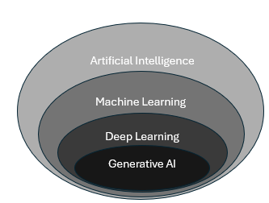
Relation ship between AI and Gen AI
Notes:
AI serves as an umbrella term for various techniques and approaches, including machine learning, deep learning, and generative AI, among others.

Slide 5
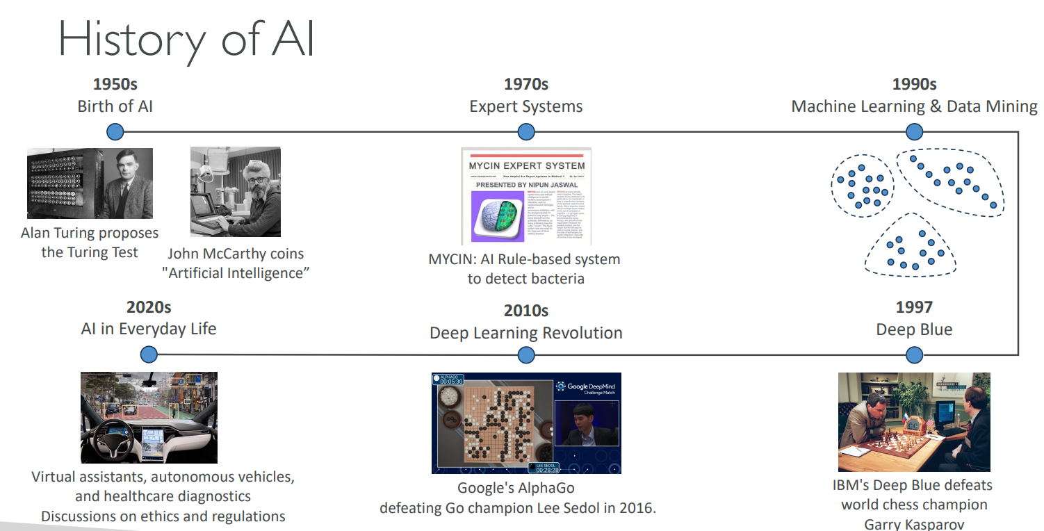
Notes:
In Turing’s version, The test was based on an adaptation of a Victorian-style game that involved the seclusion of a man and a woman from an interrogator, who must guess which is which. the computer program replaced one of the participants, and the questioner had to determine which was the computer and which was the human. If the interrogator was unable to tell the difference between the machine and the human, the computer would be considered to be thinking, or to possess “artificial intelligence.” There is another person John McCarthy, who just invented the term “Artificial intelligence”.
In the 1970, we have Expert systems. It’s a system which has AI rule based system to detect bacteria. Based on some rules it will detect bacteria.
In 1990, machine learning & data mining. There is no surprise, there are more and more data.

Slide 6
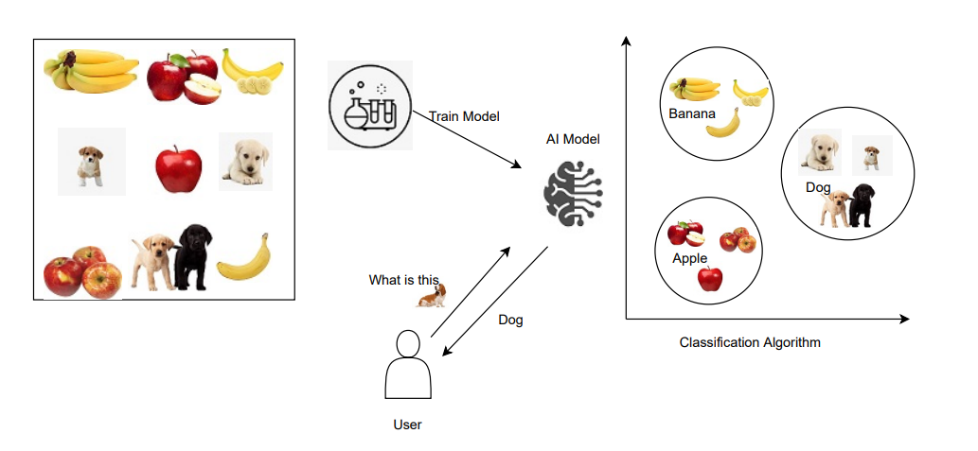
How does AI Works
Notes:
How does AI Works:
Data Layer: Collect vast amounts of data.
ML Framework and algorithm layer: Here we will create algorithm to solve the use cases provided.
Model layer: Here we implement model based on the algorithm and train it with the data.
Application layer: Model will help to server to the end users.

Slide 7
Machine Learning
Building a machine learning model involves
Training Data
ML Algorithm
Inference
Notes:
Building a machine learning model involves data collection and preparation, selecting an appropriate algorithm, training the model on the prepared data, and evaluating its performance through testing and iteration.

Slide 8
Training Data
There are a several different types of data used in training an ML model.
  Labeled: Labeled data is a dataset where each instance is accompanied by a label or target variable.
    Example: labeled data would consist of images along with their corresponding class labels (for example, cat, dog, car).
  Unlabeled: Unlabeled data is a dataset where the instances do not have any associated labels or target variables
    Example: A collection of images without any labels or annotations
  Structure Data: Is refers to data that is organized and formatted in a predefined manner. The following are types of structured data.
  Tabular data
  Time-series data
Unstructured data: is data that lacks a predefined structure or format
  Text data
  Image data
Notes:
There are a several different types of data used in training an ML model. First, it's important to know the difference between labeled and unlabeled data.
Labeled: Labeled data is a dataset where each instance or example is accompanied by a label or target variable that represents the desired output or classification. These labels are typically provided by human experts or obtained through a reliable process.
Unlabeled data
Unlabeled data is a dataset where the instances or examples do not have any associated labels or target variables. The data consists only of input features, without any corresponding output or classification.
The main types of data used in training are structured and unstructured data. They come with various subtypes, which you can find by expanding the following categories.
Structured data refers to data that is organized and formatted in a predefined manner, typically in the form of tables or databases with rows and columns. This type of data is suitable for traditional machine learning algorithms that require well-defined features and labels. The following are types of structured data.
Tabular data: This includes data stored in spreadsheets, databases, or CSV files, with rows representing instances and columns representing features or attributes.
Time-series data: This type of data consists of sequences of values measured at .
Unstructured data is data that lacks a predefined structure or format, such as text, images, audio, and video. This type of data requires more advanced machine learning techniques to extract meaningful patterns and insights.
Text data: This includes documents, articles, social media posts, and other textual data.
Image data: This includes digital images, photographs, and video frames.

Slide 9
ML Algorithm
The compiled training data is fed into machine learning algorithms.
  Supervised learning
  Unsupervised learning
  Reinforcement learning.
Notes:
The compiled training data is fed into machine learning algorithms. The ML learning process is traditionally divided into three broad categories: supervised learning, unsupervised
In supervised learning, the algorithms are trained on labeled data. The goal is to learn a mapping function that can predict the output for new, unseen input data.learning, and reinforcement learning.
Unsupervised learning refers to algorithms that learn from unlabeled data. The goal is to discover inherent patterns, structures, or relationships within the input data.
In reinforcement learning, the machine is given only a performance score as guidance and semi-supervised learning, where only a portion of training data is labeled. Feedback is provided in the form of rewards or penalties for its actions, and the machine learns from this feedback to improve its decision-making over time.

Slide 10
Inferencing
After the model has been trained, it is time to begin the process of using the information that a model has learned to make predictions or decisions. This is called inferencing.
  Batch inferencing
  Real-time inferencing
Notes:
After the model has been trained, it is time to begin the process of using the information that a model has learned to make predictions or decisions. This is called inferencing.
There are two main types of inferencing in machine learning: batch inferencing and real-time inferencing.
Batch inferencing is when the computer takes a large amount of data, such as images or text, and analyzes it all at once to provide a set of results. This type of inferencing is often used for tasks like data analysis, where the speed of the decision-making process is not as crucial as the accuracy of the results.
Real-time inferencing is when the computer has to make decisions quickly, in response to new information as it comes in. This is important for applications where immediate decision-making is critical, such as in chatbots or self-driving cars. The computer has to process the incoming data and make a decision almost instantaneously, without taking the time to analyze a large dataset.

Slide 11
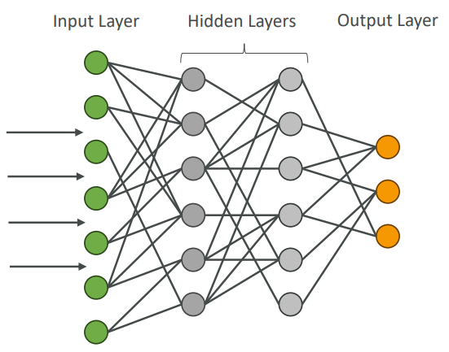
Deep Learning
The field of deep learning is inspired by the structure and function of the brain. Uses neurons and synapses (like our brain) to train a model
  Computer Vision
  Natural Language Processing (NLP)
Notes:
It involves the use of artificial neural networks, which are computational models that are designed to mimic the way the human brain processes information.
Computer Vision – image classification, object detection, image segmentation
Natural Language Processing (NLP) – text classification, sentiment analysis, machine translation, language generation

Slide 12
Generative AI(Gen AI)
Generative AI used to generate new data that is like the data it was trained on internet-scale data, and these models are called foundation models (FMs). Multi purpose foundation models backed by neural networks. They can be fine-tuned if necessary to meet business cases.
Notes:
Machine learning has been around for decades, which begs the question, what has led to the emergence of generative AI right now? The answer is as straightforward as huge investments in resources. Hiring a large team, spending on compute resources, and importantly, having the willingness to invest and develop big ideas, are all contributors to the rise of generative AI.
With FMs, instead of gathering labeled data for each model and training multiple models as in traditional ML, you can adapt a single FM to perform multiple tasks. These tasks include text generation, text summarization, information extraction, image generation, chatbot interactions, and question answering. FMs can also serve as the starting point for developing more specialized models.
Data selection
Unlabeled data can be used at scale for pre-training because it is much easier to obtain compared to labeled data. Unlabeled data includes raw data, such as images, text files, or videos, with no meaningful informative labels to provide context. FMs require training on massive datasets from diverse sources.
Pre-training
Although traditional ML models rely on supervised, unsupervised, or reinforcement learning patterns, FMs are typically pre-trained through self-supervised learning. With self-supervised learning, labeled examples are not required. Self-supervised learning makes use of the structure within the data to autogenerate labels.
During the initial pre-training stage, the FM's algorithm can learn the meaning, context, and relationship of the words in the datasets. For example, the model might learn whether drink means beverage, the noun, or swallowing the liquid, the verb.
After the initial pre-training, the model can be further pre-trained on additional data. This is known as continuous pre-training. The goal is to expand the model's knowledge base and improve its ability to understand and generalize across different domains or tasks.
Optimization
Pre-trained language models can be optimized through techniques like prompt engineering, retrieval-augmented generation (RAG), and fine-tuning on task-specific data. These methods will vary in complexity and cost and will be discussed later in this lesson.
Evaluation
Whether or not you fine-tune a model or use a pre-trained model off the shelf, the next logical step is to evaluate the model. An FM's performance can be measured using appropriate metrics and benchmarks. Evaluation of model performance and its ability to meet business needs is important.
Deployment
When the FM meets the desired performance criteria, it can be deployed in the target production environment. Deployment can involve integrating the model into applications, APIs, or other software systems.
Feedback and continuous improvement
After deployment, the model's performance is continuously monitored, and feedback is collected from users, domain experts, or other stakeholders. This feedback, along with model monitoring data, is used to identify areas for improvement, detect potential biases or drift, and inform future iterations of the model. The feedback loop permits continuous enhancement of the foundation model through fine-tuning, continuous pre-training, or re-training, as needed.

Slide 13
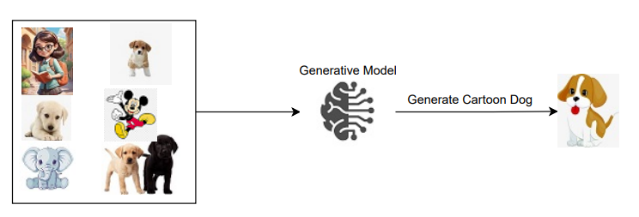
How does Gen AI works

Slide 14
Different Types of Foundation Modes
  Different Types of FM’s:
    Large Language Model(LLM)
      Tokens
      Embedding and Vectors
    Diffusion Models
      Forward Diffusion
      Reverse Diffusion
    Multimodal Models
Notes:
Large language models (LLMs) Type of AI designed to generate coherent human-like text • One notable example: GPT-4 (ChatGPT / Open AI) • Trained on large corpus of text data. Usually very big models • Billions of parameters • Trained on books, articles, websites, other textual data. Can perform language-related tasks • Translation, Summarization • Question answering • Content creation
Diffusion models
Diffusion is a deep learning architecture system that starts with pure noise or random data. The models gradually add more and more meaningful information to this noise until they end up with a clear and coherent output, like an image or a piece of text. Diffusion models learn through a two-step process of forward diffusion and reverse diffusion.
Multimodal models
Instead of just relying on a single type of input or output, like text or images, multimodal models can process and generate multiple modes of data simultaneously. For example, a multimodal model could take in an image and some text as input, and then generate a new image and a caption describing it as output.

Slide 15
Optimizing Foundation Models
A key part of the foundation model lifecycle is the optimization phase.
  Prompt engineering
  Fine-tuning
    Instruction fine-tuning
    Reinforcement learning from human feedback (RLHF)
  Retrieval-augmented generation
Notes:
An FM can be further optimized in several different ways. These techniques vary in complexity and cost, with the fastest and lowest cost option being prompt engineering.
Prompt Engineering: Prompts act as instructions for foundation models. Prompt engineering focuses on developing, designing, and optimizing prompts to enhance the output of FMs for your needs. It gives you a way to guide the model's behavior to the outcomes that you want to achieve.
A prompt's form depends on the task that you are giving to a model. As you explore prompt engineering examples, you will review prompts containing some or all of the following elements:
•Instructions: This is a task for the FM to do. It provides a task description or instruction for how the model should perform.
•Context: This is external information to guide the model.
•Input data: This is the input for which you want a response.
•Output indicator: This is the output type or format.
Fine-tunining: Although FMs are pre-trained through self-supervised learning and have inherent capability of understanding information, fine-tuning the FM base model can improve performance. Fine-tuning is a supervised learning process that involves taking a pre-trained model and adding specific, smaller datasets. Adding these narrower datasets modifies the weights of the data to better align with the task.
Instruction fine-tuning uses examples of how the model should respond to a specific instruction. Prompt tuning is a type of instruction fine-tuning.
•Reinforcement learning from human feedback (RLHF) provides human feedback data, resulting in a model that is better aligned with human preferences.
Retrieval-augmented generation (RAG) is a technique that supplies domain-relevant data as context to produce responses based on that data. This technique is similar to fine-tuning. However, rather than having to fine-tune an FM with a small set of labeled examples, RAG retrieves a small set of relevant documents and uses that to provide context to answer the user prompt. RAG will not change the weights of the foundation model, whereas fine-tuning will change model weights.

Slide 16
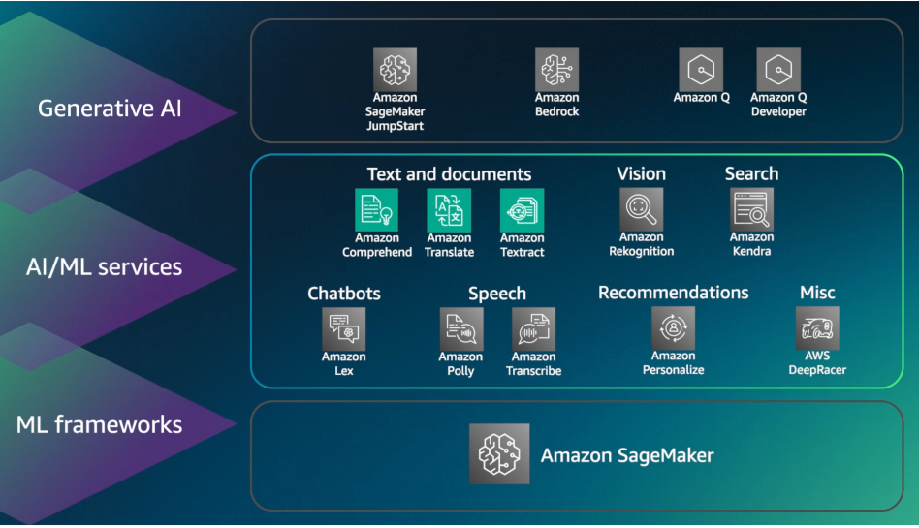
AWS Infrastructure and technologies for AI and ML
Notes:
AWS offers a comprehensive suite of ML and generative AI services that unlock the full potential of these transformative technologies.

Slide 17
ML Frameworks
SageMaker Is a fully managed machine learning platform that enables developers and data scientists to build, train, deploy and manage machine learning models.
  Studio
  Canvas
  Data wrangler
  Clarify
  Debugger
  Autopilot
  Pipelines
  Feature Store
  Ground truth
  Monitor
  EdnPoint
Notes:
ML Framework: SageMaker offers the right tools to effectively build, train and run LLM and other FM models efficiently and cost effectively.
SageMaker removes heavy lifting from each step of the ML process to make it easier to developer high quality models.
SageMaker provides all the components used for ML in a single toolset, so model get to production much faster with less efforts and less cost.
Studio: A web based IDE for machine learning development. While it requires some coding, it offers a simplified environment.
Canvas: A visual interface for building machine learning models without writing code.
Data wrangler: Prepares and cleans data for machine learning.
Clarify: Provides tools for analyzing model predictions and detecting bias,
Debugger: Provides tools for debugging and profiling ML models.
Autopilot: Automatically trains and tunes machine learning models.
Pipelines: Service for building and automating ML pipelines
Feature Store: Fully managed, purpose built repository to store, update, retrieve and share ML features.
Ground truth: Builds high quality training data sets for improved model accuracy.
Monitor: Monitor the performance of ML models in production.
EdnPoint: Hosts machine learning models for real time inference.

Slide 18
AI/ML Services
AWS Provides a robust AI/ML services layer, offering ready to use solutions.
  Amazon Comprehend
  Amazon Translate
  Amazon Transcribe
  Amazon Polly
  Amazon Rekognition
  Amazon Lex
  Amazon Personalize
  Amazon Textract
  Amazon Kendra
  Amazon Deep Racer
Notes:
AI/ML Services: AWS Provides a robust AI/ML services layer, offering ready to use solutions. This layer includes a wide range of services that provide developers with AI/ML capabilities without requiring extensive infrastructure management or specialized expertise.
Amazon Comprehend:
This uses ML and Natural language process(NLP) to help uncover insights and relationships in the unstructured data.
It identifies the language of the text and extras key phrases, places, people, brand or events.
Also understand sensitivity of the text.
Best example use cases are : 1. Analyzing customer emails. 2. Categorize the emails by the topic. 3.
Amazon translate:
Language translator. It helps to localize content.
Best use case: internalization of your web sites.
Amazon Transcribe:
Is a speech recognition service converts speech to a text.
Examples: Subtitles for a movie, transcribing customer calls…
Amazon Polly:
Is service that converts text into speech.
Usecases: Public speech annoucements..
Amazon Rekognition:
This used to identify objects, people, places, text, scenes and activities in the images and videos.
Use cases: Facial analysis, facial search capabilities, counting people in auditorium, cricket match 3rd empire review :)
Amazon Lex:
Used to design, build , test and deploy ChatBot application using text or voice.
Use cases: Ordering pizza chat bot, customer service chat bot, hotel reservation chatbot…
Amazon Personalize:
Used to provide individuals recommendations to the customers.
Use cases: Retail stores, movie suggestions, medicine…
Amazon Textract:
Its automatically extracts text data from scanned documents.
Use case: Medical claim, financial report, tax forms, passport processing…
Amazon Kendra:
Is an intelligent document search service.
Use cases: KT Documentation search with in the organization.
Amazon DeepRacer:
Is a fun way of getting started with Reinforcement learning.

Slide 19
Generative AI
Generative AI layer offers a suite of powerful tools and services specially designed for generative AI tasks.
  Sage Maker Jump Start
  Amazon Bedrock
  Amazon Q
  Amazon Q Developer
Notes:
Generative AI layer offers a suite of powerful tools and services specially designed for generative AI tasks.
Sage Maker Jump Start: Is helps to quickly get started with ML. Sage Maker provides solutions for most common use cases which can be rapidly developed and deployed. Is on stop place where we can develop, deploy and fine tune FM models.
Amazon Bedrock: Amazon Bedrock is a fully managed service that makes FMs(Foundation models) from Amazon and leading AI startups available through an API. With the Amazon Bedrock serverless experience, you can quickly get started, experiment with FMs, privately customize them with your own data, and seamlessly integrate and deploy FMs into your AWS applications.
Amazon Q: Can you helps to get fast, relevant to process questions, solve problems, generate content and take actions using the data provided by the company repositories. Its like a GenAI Support tool for internal employees.
Use cases: Create job post for your company, post in social media about your company new product.
Amazon Q Developer: Its a ML powered code recommendations to accelerate development in Java, python, C#, typescript applications. The service integrate with multiple integrated development environments and helps developers to write code faster. It also helps to answer questions about aws services.

Slide 20
Advantages of AWS AI Services
AWS offers top-notch security and privacy features to keep your data safe and it gives you access to the most advanced AI models available.
  Accelerate development and deployment
  Scalability and cost optimization
  Flexibility and access to model
  Integration with AWS Tools and services
Notes:
AWS offers top-notch security and privacy features to keep your data safe and it gives you access to the most advanced AI models available. AWS helps you take advantage of generative AI technology and create something truly unique and personalized.
Accelerate development and deployment:
Using amazon Q Developer, we can generate code in real time.
Sage Maker handles tasks such as data preprocessing, model training and deployment. So that developers can focus on application logic and user experience.
Amazon bed rocks access pre-trained models and API's. So developers can quickly integrate AI capabilities into their application with out extensive trainings or specialized infrastructure.
Scalability and cost optimization:
With pay-as-you-go pricing model, business will pay for the resources what they used. This reduces upfront cost.
AWS Global infrastructure and distributed computing capabilities permits applications to scale seamlessly across regions and handle large datasets or high-value traffic.
Flexibility and access to model:
AWS continuously update and expands its AI services, to providing access to the latest advancements in machine learning models, techniques and algorithms.
Amazon bedrock offers a choice of high performing FM's from AI leading companies like AI21 labs, Anthropic, Cohere, Meta, Stability AI and AWS, through a single API.
Integration with AWS tools and services:
Services like Amazon comprehend and Amazon Rekogniztion offers ready to use AI capabilities that can be readily integrated into applications.
AWS AI Services seamlessly integrated with other AWS services, so that developers can provide end to end solutions that use multiple cloud services.
AWS eco system provide wide range of tools like SDK's and API's. So that developers can

Slide 21
Cost considerations
As training FM’s and building infrastructure is most difficult and involves lot of cost. We need to understand how it works in overall.
  Responsiveness and availability
  Redundancy and reginal coverage
  Performance
  Token based pricing
  Provision throughput
  Custom models
Notes:
Responsiveness and availability: AWS Generative AI services are designed to be high responsiveness and available. However, high levels of availability and responsiveness will cost more. For example, services lower latency and high availability will typical have high cost compare to lower performance.
Redundancy and reginal coverage: To ensure redundancy and regional coverage, AWS Generative AI services will deploy into multiple availability zones across multiple regions. This might cause some additional cost as well.
Performance: AWS offers different compute options for generative AI services. High performance options such as GPU will be higher cost but it will be significant performance improvements for certain workloads.
Token based pricing: Many amazon AI Services are token based pricing services. For example, Amazon Q developer and Amazon bedrock uses token based pricing. That means, you pay for the number of tokens generated or process by the service.
Provision throughput: Some of the services like amazon polly and amazon transcribe will let you provision specific throughput in advance. Higher throughput typically come at higher cost.
Custom models: Amazon AI Services allow to custom models or fine tune FM's. Training and deploying custom models will incur some cost depending on complexity of the model, training data and compute resources required.

Slide 22
Support Tool(s)
AWS Bedrock Agents: Agents for Amazon Bedrock plan and execute multistep tasks using company systems and data sources—from answering customer questions about your product availability to taking their orders.
Benefits of using Agents:
  Multi-agent collaboration
  Retrieval augmented generation Agents
  Orchestrate and execute multistep tasks
  Memory retention across interactions
  Prompt engineering
Notes:
With Amazon Bedrock, you can create an agent in just a few quick steps by first selecting an FM and providing it access to your enterprise systems, knowledge bases, and AWS Lambda functions to securely execute your APIs. An agent analyzes the user request and automatically calls the necessary APIs and data sources to fulfill the request. Agents for Amazon Bedrock offer enhanced security and privacy—no need for you to engineer prompts, manage session context, or manually orchestrate tasks.
Multi-agent collaboration
Amazon Bedrock multi-agent collaboration allows developers to build, deploy, and manage multiple specialized agents seamlessly working together to address increasingly complex business workflows.
Each agent focuses on specific tasks under the coordination of a supervisor agent, which breaks down intricate processes into manageable steps to ensure precision and reliability.
By automating these complex operational processes, businesses can free their teams from operational burdens, allowing them to focus on innovation and deliver real business value.
Retrieval augmented generation
Agents securely connect to your company’s data sources and augment the user request with the right information to generate an accurate response.
Orchestrate and execute multistep tasks
Customers can create an agent in Amazon Bedrock in just a few quick steps, accelerating the time it takes to build generative AI applications. Customers first select a model and write a few instructions in natural language, for example, “you are an inventory management agent that determines product availability in the inventory system”. Agents orchestrate and analyze the task and break it down into the correct logical sequence using the FM’s reasoning abilities. Agents automatically call the necessary APIs to transact with the company systems and processes to fulfill the request, determining along the way if they can proceed or if they need to gather more information.
Memory retention across interactions
Agents have the ability to retain memory across interactions, offering more personalized and seamless user experiences. This feature allows an agent to remember historical interactions and improves the accuracy of multistep tasks. Users benefit from improved recommendations and recall of prior context when required, ensuring a more cohesive and efficient interaction with the agent.
Prompt engineering
Agents automatically create a prompt template from the user instructions, action group, and knowledge bases. You can use this template as a baseline to further refine the automatically generated prompt template to enhance the user experience. You can also update the user input, orchestration plan, and the FM response. Lastly, with the ability to modify the prompt template, you gain better control over the agent orchestration.

Slide 23
Real time Image process
Amazon Rekognition automates your image and video analysis with ML and analyzes millions of images, live streams, and stored videos in seconds.
Notes:
Using AWS Rekognition, we can get the real time processing data now we can process that data using other tools like AWS Comprehend, textract and distribute the data into multiple platforms where it can be used or integrated into other services.

Slide 24
Thank You
Q&A

